Slide 1
Atalantis
Wildhacks 2014
Sam Cohen, Stan Huang, Sophia Lou, Edwin Wu, Wayne Xun

Slide 2

Atalantis
Atalantis

Slide 3

Atalantis
Home Run Info Funds
84
Miles Run
mi
14
Miles to Goal
mi
Options

Slide 4
Atalantis
Home Run Info Funds
4.2
Distance Traveled
mi
Time Elapsed
0:53
:23
Options

Slide 5
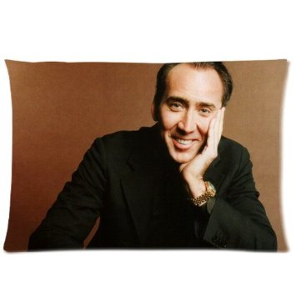
Atalantis
Home Run Info Funds
98
Next Milestone
Next Reward
Nicolas Cage Pillowcase…
Options

Slide 6
Atalantis
Home Run Info Funds
$43
Account Funds
$16
Gift Funds
Add Funds

